Slide 1
Language Models
Hongning Wang
CS@UVa

Slide 2
Notion of Relevance
Relevance
Δ(Rep(q), Rep(d))
Similarity
P(r=1|q,d) r ∈{0,1}
Probability of Relevance
P(d →q) or P(q →d)
Probabilistic inference
Regression
Model
(Fox 83)
Generative Model
Different
inference system
Different
rep & similarity
Doc
generation
Query
generation
…
Prob. concept
space model
(Wong & Yao, 95)
Inference
network
model
(Turtle & Croft, 91)
Vector space
model
(Salton et al., 75)
Prob. distr.
model
(Wong & Yao, 89)
Classical
prob. Model
(Robertson &
Sparck Jones, 76)
LM approach
(Ponte & Croft, 98)
(Lafferty & Zhai, 01a)

Slide 3
What is a statistical LM?
A model specifying probability distribution over word sequences
p(“Today is Wednesday”) ≈ 0.001
p(“Today Wednesday is”) ≈ 0.0000000000001
p(“The eigenvalue is positive”) ≈ 0.00001
It can be regarded as a probabilistic mechanism for “generating” text, thus also called a “generative” model

Slide 4
Why is a LM useful?
Provides a principled way to quantify the uncertainties associated with natural language
Allows us to answer questions like:
Given that we see “John” and “feels”, how likely will we see “happy” as opposed to “habit” as the next word?
(speech recognition)
Given that we observe “baseball” three times and “game” once in a news article, how likely is it about “sports”?
(text categorization, information retrieval)
Given that a user is interested in sports news, how likely would the user use “baseball” in a query?
(information retrieval)

Slide 5
Source-Channel framework ^{[Shannon 48]}
Source
Transmitter
(encoder)
Noisy
Channel
Receiver
(decoder)
Destination
X
Y
X’
P(X)
P(X|Y)=?
P(Y|X)
(Bayes Rule)
When X is text, p(X) is a language model
Many Examples:
Speech recognition: X=Word sequence Y=Speech signal
Machine translation: X=English sentence Y=Chinese sentence
OCR Error Correction: X=Correct word Y= Erroneous word
Information Retrieval: X=Document Y=Query
Summarization: X=Summary Y=Document

Slide 6
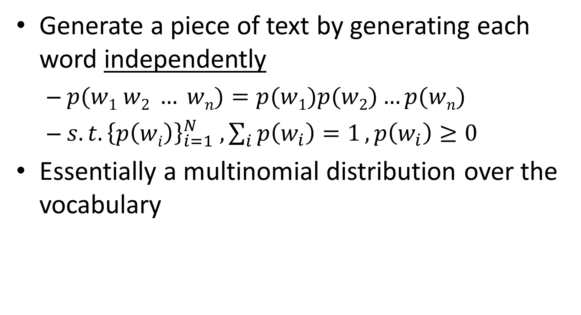
Unigram language model
Generate a piece of text by generating each word independently
$p(w1 w2 … wn)=p(w1)p(w2)…p(wn)$
${s.t. \left\{p\left(wi\right)\right\}}_{i=1}^{N} , \sum_{i}{p\left(w_{i}\right)=1}, p\left(w_{i}\right)≥0$
Essentially a multinomial distribution over the vocabulary
The simplest and most popular choice!

Slide 7
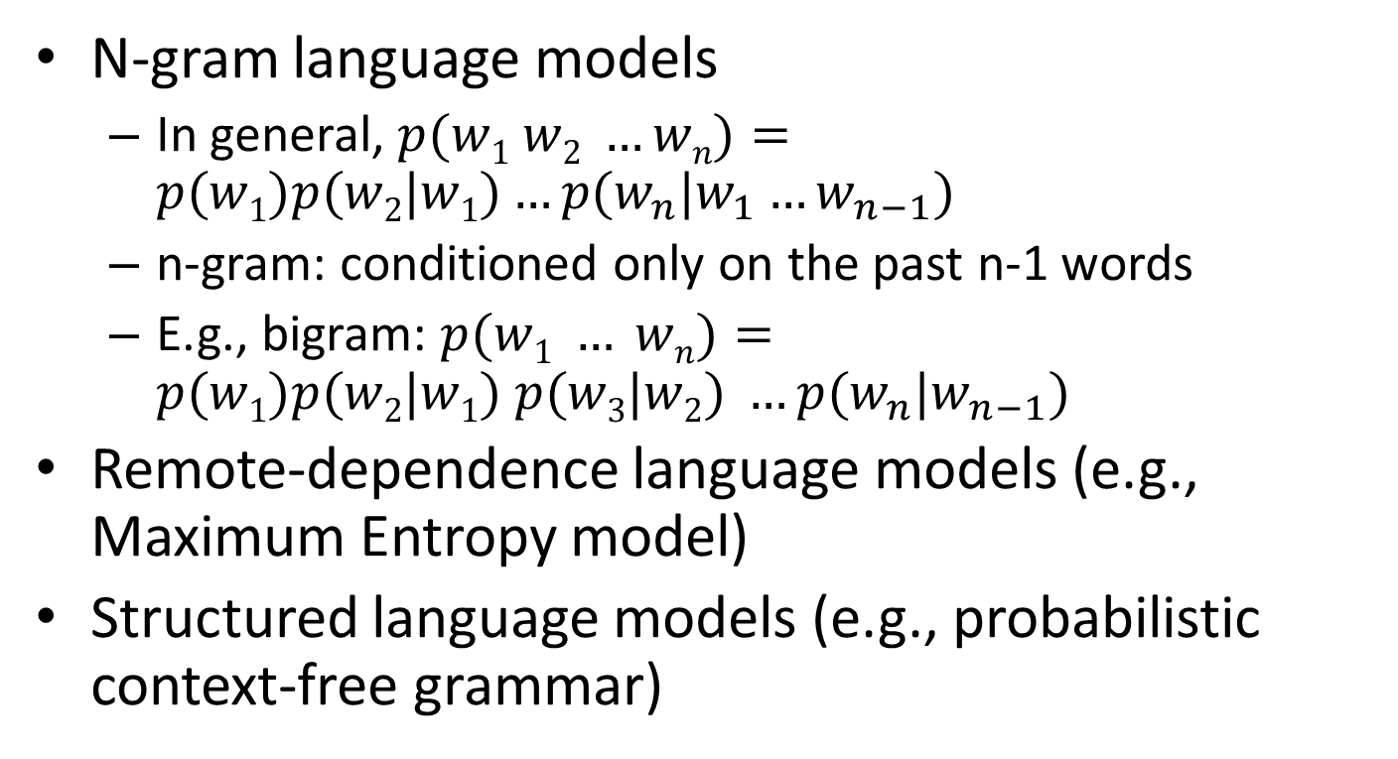
More sophisticated LMs
N-gram language models
In general, $p(w1 w2 …wn)=p(w1)p(w2|w1)…p(w_{n}|w_{1}…w_{n−1})$
n-gram: conditioned only on the past n-1 words
E.g., bigram: $p(w1 … wn)=p(w1)p(w2|w1) p(w3|w2) …p(w_{n}|w_{n−1})$
Remote-dependence language models (e.g., Maximum Entropy model)
Structured language models (e.g., probabilistic context-free grammar)

Slide 8
Why just unigram models?
Difficulty in moving toward more complex models
They involve more parameters, so need more data to estimate
They increase the computational complexity significantly, both in time and space
Capturing word order or structure may not add so much value for “topical inference”
But, using more sophisticated models can still be expected to improve performance ...

Slide 9
Generative view of text documents
(Unigram) Language Model θ
p(w| θ)
Sampling
Document
…
text 0.2
mining 0.1
assocation 0.01
clustering 0.02
…
food 0.00001
…
Topic 1:
Text mining
Text mining
document
…
text 0.01
food 0.25
nutrition 0.1
healthy 0.05
diet 0.02
…
Food nutrition
document
Topic 2:
Health

Slide 10
Estimation of language models
Maximum likelihood estimation
Unigram Language Model θ
p(w| θ)=?
Estimation
Document
…
text ?
mining ?
assocation ?
database ?
…
query ?
…
text 10
mining 5
association 3
database 3
algorithm 2
…
query 1
efficient 1
10/100
5/100
3/100
3/100
1/100
A “text mining” paper
(total #words=100)

Slide 11
Language models for IR ^{[Ponte & Croft SIGIR’98]}
Document
Language Model
Query
…
text ?
mining ?
assocation ?
clustering ?
…
food ?
…
Text mining
paper
?
“data mining algorithms”
…
food ?
nutrition ?
healthy ?
diet ?
…
Food nutrition
paper
Which model would most
likely have generated this query?

Slide 12
Ranking docs by query likelihood
Doc LM
Query likelihood
d₁
θ_{d1}
p(q| θ_{d1})
q
d₂
θ_{d2}
p(q| θ_{d2})
……
……
p(q| θ_{dN})
d_{N}
θ_{dN}
Justification: PRP

Slide 13
Justification from PRP
Query generation
Query likelihood p(q| θ_{d})
Document prior
Assuming uniform document prior, we have

Slide 14
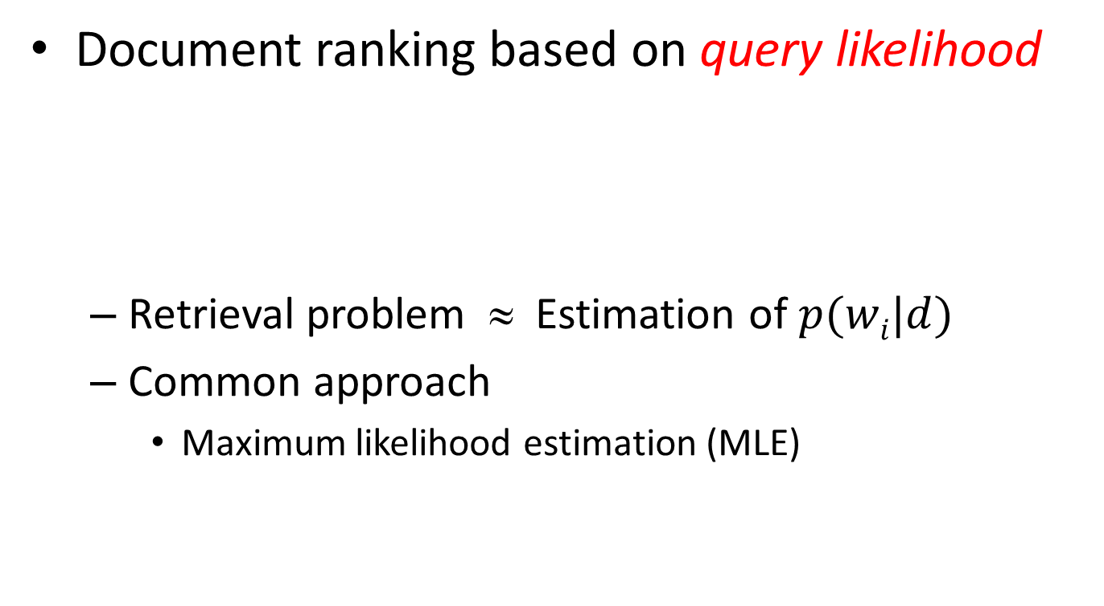
Retrieval as language model estimation
Document ranking based on query likelihood
Retrieval problem ≈ Estimation of $p(wi|d)$
Common approach
Maximum likelihood estimation (MLE)
Document language model

Slide 15
Problem with MLE
What probability should we give a word that has not been observed in the document?
log0?
If we want to assign non-zero probabilities to such words, we’ll have to discount the probabilities of observed words
This is so-called “smoothing”

Slide 16
General idea of smoothing
All smoothing methods try to
Discount the probability of words seen in a document
Re-allocate the extra counts such that unseen words will have a non-zero count

Slide 17
Illustration of language model smoothing
P(w|d)
Max. Likelihood Estimate
Smoothed LM
w
Discount from the seen words
Assigning nonzero probabilities to the unseen words

Slide 18
Smoothing methods
Method 1: Additive smoothing
Add a constant δ to the counts of each word
Problems?
Hint: all words are equally important?
Counts of w in d
“Add one”, Laplace smoothing
Vocabulary size
Length of d (total counts)

Slide 19
Refine the idea of smoothing
Should all unseen words get equal probabilities?
We can use a reference model to discriminate unseen words
Discounted ML estimate
Reference language model

Slide 20
Smoothing methods (cont)
Method 2: Absolute discounting
Subtract a constant δ from the counts of each word
Problems?
Hint: varied document length?
# uniq words

Slide 21
Smoothing methods (cont)
Method 3: Linear interpolation, Jelinek-Mercer
“Shrink” uniformly toward p(w|REF)
Problems?
Hint: what is missing?
parameter
MLE

Slide 22
Smoothing methods (cont)
Method 4: Dirichlet Prior/Bayesian
Assume pseudo counts μp(w|REF)
Problems?
parameter

Slide 23
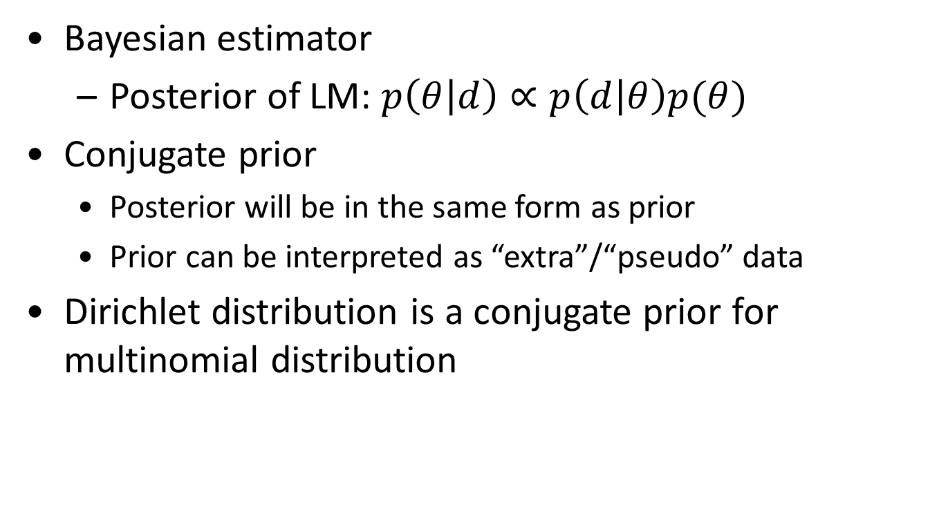
Dirichlet prior smoothing
likelihood of doc given the model
Bayesian estimator
Posterior of LM: $p\left(θ | d\right)∝p\left(d | θ\right)p(θ)$
Conjugate prior
Posterior will be in the same form as prior
Prior can be interpreted as “extra”/“pseudo” data
Dirichlet distribution is a conjugate prior for multinomial distribution
prior over models
“extra”/“pseudo” word counts, we set α_{i}=μ p(w_{i}|REF)

Slide 24
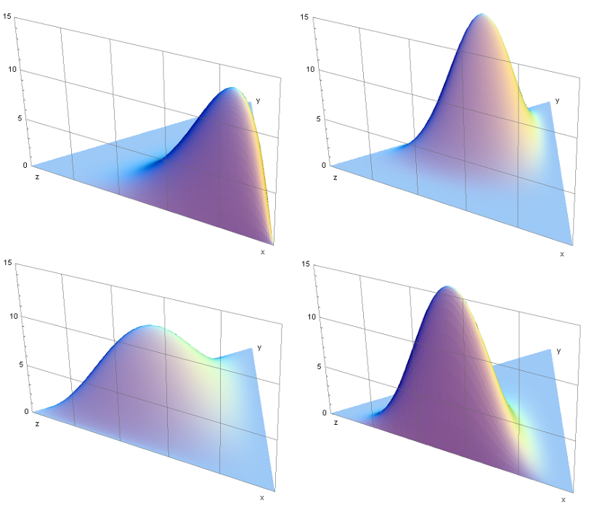
Some background knowledge
Conjugate prior
Posterior dist in the same family as prior
Dirichlet distribution
Continuous
Samples from it will be the parameters in a multinomial distribution
Gaussian -> Gaussian
Beta -> Binomial
Dirichlet -> Multinomial

Slide 25
Dirichlet prior smoothing (cont)
Posterior distribution of parameters:
The predictive distribution is the same as the mean:
Dirichlet prior smoothing

Slide 26
Estimating μ using leave-one-out ^{[Zhai & Lafferty 02]}
w₁
Leave-one-out
P(w₁|d_{- w1})
log-likelihood
w₂
P(w₂|d_{- w2})
Maximum Likelihood Estimator
...
w_{n}
P(w_{n}|d_{- wn})

Slide 27
Why would “leave-one-out” work?
20 word by author1
abc abc ab c d d
abc cd d d
abd ab ab ab ab
cd d e cd e
Now, suppose we leave “e” out…
μ doesn’t have to be big
20 word by author2
abc abc ab c d d
abe cb e f
acf fb ef aff abef
cdc db ge f s
μ must be big! more smoothing
The amount of smoothing is closely related to
the underlying vocabulary size

Slide 28




Understanding smoothing
Content words
Query = “the algorithms for data mining”
p_{ML}(w|d1): 0.04 0.001 0.02 0.002 0.003
p_{ML}(w|d2): 0.02 0.001 0.01 0.003 0.004
$$4.8×{10}^{−12}$$
$$2.4×{10}^{−12}$$
p( “algorithms”|d1) = p(“algorithm”|d2)
p( “data”|d1) < p(“data”|d2)
p( “mining”|d1) < p(“mining”|d2)
Intuitively, d2 should have a higher score,
but p(q|d1)>p(q|d2)…
So we should make p(“the”) and p(“for”) less different for all docs,
and smoothing helps to achieve this goal…
$$2.35×{10}^{−13}$$
$$4.53×{10}^{−13}$$
Query = “the algorithms for data mining”
P(w|REF) 0.2 0.00001 0.2 0.00001 0.00001
Smoothed p(w|d1): 0.184 0.000109 0.182 0.000209 0.000309
Smoothed p(w|d2): 0.182 0.000109 0.181 0.000309 0.000409

Slide 29
Understanding smoothing
Plug in the general smoothing scheme to the query likelihood retrieval formula, we obtain
Doc length normalization
(longer doc is expected to have a smaller α_{d})
TF weighting
IDF weighting
Ignore for ranking
Smoothing with p(w|C) ≈ TF-IDF + doc-length normalization

Slide 30
Smoothing & TF-IDF weighting
Smoothed ML estimate
Retrieval formula using the general smoothing scheme
Reference language model
$$c\left(w,q\right)>0$$
Key rewriting step (where did we see it before?)
Similar rewritings are very common when using probabilistic models for IR…

Slide 31
What you should know
How to estimate a language model
General idea and different ways of smoothing
Effect of smoothing

